Slide 1

Map-Reduce and the New Software Stack
Note to other teachers and users of these slides: We would be delighted if you found this our material useful in giving your own lectures. Feel free to use these slides verbatim, or to modify them to fit your own needs. If you make use of a significant portion of these slides in your own lecture, please include this message, or a link to our web site: http://www.mmds.org
Mining of Massive Datasets
Jure Leskovec, Anand Rajaraman, Jeff Ullman Stanford University
http://www.mmds.org

Slide 2
MapReduce
Much of the course will be devoted to large scale computing for data mining
Challenges:
How to distribute computation?
Distributed/parallel programming is hard
Map-reduce addresses all of the above
Google’s computational/data manipulation model
Elegant way to work with big data

Slide 3
Single Node Architecture
CPU
Machine Learning, Statistics
Memory
“Classical” Data Mining
Disk

Slide 4
Motivation: Google Example
20+ billion web pages x 20KB = 400+ TB
1 computer reads 30-35 MB/sec from disk
~4 months to read the web
~1,000 hard drives to store the web
Takes even more to do something useful with the data!
Today, a standard architecture for such problems is emerging:
Cluster of commodity Linux nodes
Commodity network (ethernet) to connect them

Slide 5
Cluster Architecture
2-10 Gbps backbone between racks
1 Gbps between
any pair of nodes
in a rack
Switch
Switch
Switch
CPU
CPU
CPU
CPU
Mem
…
Mem
Mem
…
Mem
Disk
Disk
Disk
Disk
Each rack contains 16-64 nodes
In 2011 it was guestimated that Google had 1M machines, http://bit.ly/Shh0RO

Slide 6
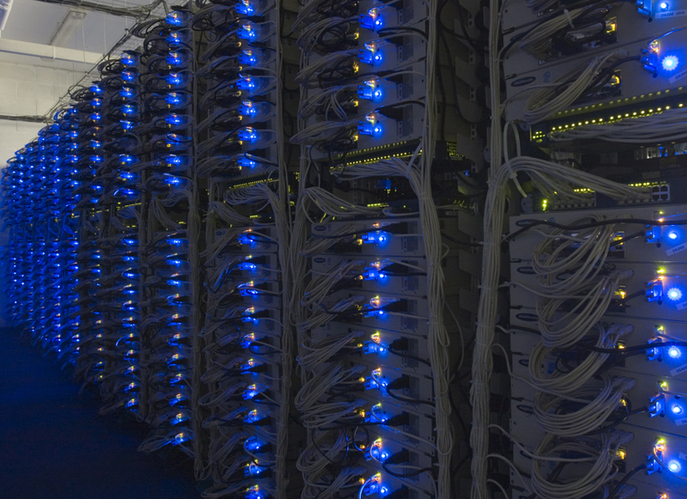

Slide 7
Large-scale Computing
Large-scale computing for data mining problems on commodity hardware
Challenges:
How do you distribute computation?
How can we make it easy to write distributed programs?
Machines fail:
One server may stay up 3 years (1,000 days)
If you have 1,000 servers, expect to loose 1/day
People estimated Google had ~1M machines in 2011
1,000 machines fail every day!

Slide 8
Idea and Solution
Issue: Copying data over a network takes time
Idea:
Bring computation close to the data
Store files multiple times for reliability
Map-reduce addresses these problems
Google’s computational/data manipulation model
Elegant way to work with big data
Storage Infrastructure – File system
Google: GFS. Hadoop: HDFS
Programming model
Map-Reduce

Slide 9
Storage Infrastructure
Problem:
If nodes fail, how to store data persistently?
Answer:
Distributed File System:
Provides global file namespace
Google GFS; Hadoop HDFS;
Typical usage pattern
Huge files (100s of GB to TB)
Data is rarely updated in place
Reads and appends are common

Slide 10
Distributed File System
Chunk servers
File is split into contiguous chunks
Typically each chunk is 16-64MB
Each chunk replicated (usually 2x or 3x)
Try to keep replicas in different racks
Master node
a.k.a. Name Node in Hadoop’s HDFS
Stores metadata about where files are stored
Might be replicated
Client library for file access
Talks to master to find chunk servers
Connects directly to chunk servers to access data

Slide 11
Distributed File System
Reliable distributed file system
Data kept in “chunks” spread across machines
Each chunk replicated on different machines
Seamless recovery from disk or machine failure
C₀
C₁
D₀
C₁
C₂
C₅
C₀
C₅
…
C₅
Chunk server 1
C₂
C₅
Chunk server 2
C₃
D₀
Chunk server 3
D₁
D₀
Chunk server N
C₂
Bring computation directly to the data!
Chunk servers also serve as compute servers
Notes:
11

Slide 12
Map/Reduce
Map/Reduce
Programming model from Lisp
(and other functional languages)
Many problems can be phrased this way
Easy to distribute across nodes
Nice retry/failure semantics

Slide 13
Map in Lisp (Scheme)
(map f list [list₂ list₃ …])
(map square ‘(1 2 3 4))
(1 4 9 16)
(reduce + ‘(1 4 9 16))
(+ 16 (+ 9 (+ 4 1) ) )
30
(reduce + (map square (map – l₁ l₂))))
Unary operator
Binary operator
What does this remind you of?
Map ~~ select row by row
Reduce ~~ aggregation

Slide 14
Map/Reduce ala Google
map(key, val) is run on each item in set
emits new-key / new-val pairs
reduce(key, vals) is run for each unique key emitted by map()
emits final output

Slide 15
Programming Model: MapReduce
Warm-up task:
We have a huge text document
Count the number of times each distinct word appears in the file
Sample application:
Analyze web server logs to find popular URLs

Slide 16
Task: Word Count
Case 1:
File too large for memory, but all <word, count> pairs fit in memory
Case 2:
Count occurrences of words:
words(doc.txt) | sort | uniq -c
where words takes a file and outputs the words in it, one per a line
Case 2 captures the essence of MapReduce
Great thing is that it is naturally parallelizable

Slide 17
Count Words in Docs
Input consists of (url, contents) pairs
map(key=url, val=contents):
For each word w in contents, emit (w, “1”)
reduce(key=word, values=uniq_counts):
Sum all “1”s in values list
Emit result “(word, sum)”

Slide 18
Count, Illustrated
map(key=url, val=contents):
For each word w in contents, emit (w, “1”)
reduce(key=word, values=uniq_counts):
Sum all “1”s in values list
Emit result “(word, sum)”
see 1
bob 1
run 1
see 1
spot 1
throw 1
bob 1
run 1
see 2
spot 1
throw 1
see bob throw
see spot run

Slide 19
Grep
Input consists of (regexp, file)
map(key=regexp, val=file):
If contents matches regexp, emit (line, “1”)
reduce(key=line, values=uniq_counts):
Don’t do anything; just emit line

Slide 20
Reverse Web-Link Graph
Map
For each URL linking to target, …
Output <target, source> pairs
Reduce
Concatenate list of all source URLs
Outputs: <target, list (source)> pairs

Slide 21
Inverted Index
Map
parses each document,
emits a sequence of <word, document ID> pairs
Reduce
accepts all pairs for a given word, sorts the corresponding document IDs
emits a <word, list(document ID)> pair

Slide 22
MapReduce: Overview
Sequentially read a lot of data
Map:
Extract something you care about
Group by key: Sort and Shuffle
Reduce:
Aggregate, summarize, filter or transform
Write the result
Outline stays the same, Map and Reduce change to fit the problem

Slide 23
MapReduce: The Map Step
Input
key-value pairs
Intermediate
key-value pairs
k
v
map
k
v
k
v
map
k
v
k
v
…
…
k
v
k
v

Slide 24
MapReduce: The Reduce Step
Output
key-value pairs
Intermediate
key-value pairs
Key-value groups
reduce
k
v
k
v
v
v
k
v
Group
by key
reduce
k
v
k
v
v
k
v
k
v
…
…
…
k
v
k
v
k
v

Slide 25
More Specifically
Input: a set of key-value pairs
Programmer specifies two methods:
Map(k, v) → <k’, v’>*
Takes a key-value pair and outputs a set of key-value pairs
E.g., key is the filename, value is a single line in the file
There is one Map call for every (k,v) pair
Reduce(k’, <v’>*) → <k’, v’’>*
All values v’ with same key k’ are reduced together and processed in v’ order
There is one Reduce function call per unique key k’

Slide 26
MapReduce: Word Counting
Provided by the programmer
Provided by the programmer
MAP:
Read input and produces a set of key-value pairs
Group by key:
Collect all pairs with same key
Reduce:
Collect all values belonging to the key and output
The crew of the space shuttle Endeavor recently returned to Earth as ambassadors, harbingers of a new era of space exploration. Scientists at NASA are saying that the recent assembly of the Dextre bot is the first step in a long-term space-based man/mache partnership. '"The work we're doing now -- the robotics we're doing -- is what we're going to need ……………………..
(The, 1)
(crew, 1)
(of, 1)
(the, 1)
(space, 1)
(shuttle, 1)
(Endeavor, 1)
(recently, 1)
….
(crew, 1)
(crew, 1)
(space, 1)
(the, 1)
(the, 1)
(the, 1)
(shuttle, 1)
(recently, 1)
…
(crew, 2)
(space, 1)
(the, 3)
(shuttle, 1)
(recently, 1)
…
Sequentially read the data
Only sequential reads
Big document
(key, value)
(key, value)
(key, value)

Slide 27
Word Count Using MapReduce
map(key, value):
// key: document name; value: text of the document
for each word w in value:
emit(w, 1)
reduce(key, values):
// key: a word; value: an iterator over counts
result = 0
for each count v in values:
result += v
emit(key, result)

Slide 28
Map-Reduce: Environment
Map-Reduce environment takes care of:
Partitioning the input data
Scheduling the program’s execution across a set of machines
Performing the group by key step
Handling machine failures
Managing required inter-machine communication

Slide 29
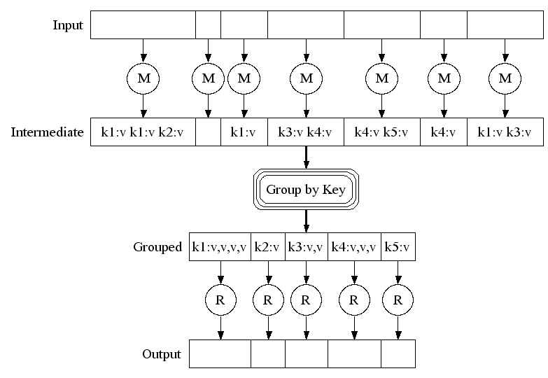
Map-Reduce: A diagram
Big document
MAP:
Read input and produces a set of key-value pairs
Group by key:
Collect all pairs with same key
(Hash merge, Shuffle, Sort, Partition)
Reduce:
Collect all values belonging to the key and output

Slide 30
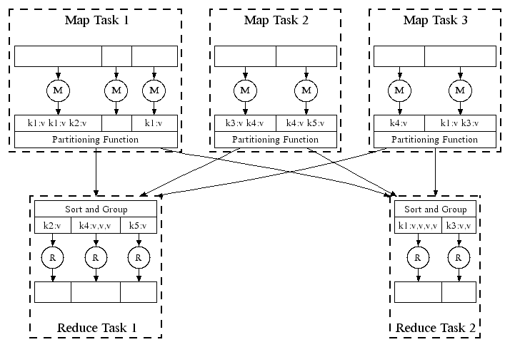
Map-Reduce: In Parallel
All phases are distributed with many tasks doing the work

Slide 31
Map-Reduce
Programmer specifies:
Map and Reduce and input files
Workflow:
Read inputs as a set of key-value-pairs
Map transforms input kv-pairs into a new set of k'v'-pairs
Sorts & Shuffles the k'v'-pairs to output nodes
All k’v’-pairs with a given k’ are sent to the same reduce
Reduce processes all k'v'-pairs grouped by key into new k''v''-pairs
Write the resulting pairs to files
All phases are distributed with many tasks doing the work
Input 0
Input 1
Input 2
Map 0
Map 1
Map 2
Shuffle
Reduce 0
Reduce 1
Out 0
Out 1

Slide 32
Data Flow
Input and final output are stored on a distributed file system (FS):
Scheduler tries to schedule map tasks “close” to physical storage location of input data
Intermediate results are stored on local FS of Map and Reduce workers
Output is often input to another MapReduce task

Slide 33
Coordination: Master
Master node takes care of coordination:
Task status: (idle, in-progress, completed)
Idle tasks get scheduled as workers become available
When a map task completes, it sends the master the location and sizes of its R intermediate files, one for each reducer
Master pushes this info to reducers
Master pings workers periodically to detect failures

Slide 34
Dealing with Failures
Map worker failure
Map tasks completed or in-progress at worker are reset to idle
Reduce workers are notified when task is rescheduled on another worker
Reduce worker failure
Only in-progress tasks are reset to idle
Reduce task is restarted
Master failure
MapReduce task is aborted and client is notified

Slide 35
How many Map and Reduce jobs?
M map tasks, R reduce tasks
Rule of a thumb:
Make M much larger than the number of nodes in the cluster
One DFS chunk per map is common
Improves dynamic load balancing and speeds up recovery from worker failures
Usually R is smaller than M
Because output is spread across R files

Slide 36
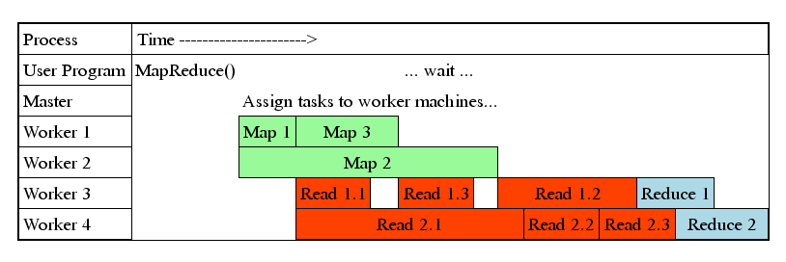
Task Granularity & Pipelining
Fine granularity tasks: map tasks >> machines
Minimizes time for fault recovery
Can do pipeline shuffling with map execution
Better dynamic load balancing

Slide 37
Refinements: Backup Tasks
Problem
Slow workers significantly lengthen the job completion time:
Other jobs on the machine
Bad disks
Weird things
Solution
Near end of phase, spawn backup copies of tasks
Whichever one finishes first “wins”
Effect
Dramatically shortens job completion time

Slide 38
Refinement: Combiners
Often a Map task will produce many pairs of the form (k,v₁), (k,v₂), … for the same key k
E.g., popular words in the word count example
Can save network time by pre-aggregating values in the mapper:
combine(k, list(v₁)) → v₂
Combiner is usually same as the reduce function
Works only if reduce function is commutative and associative

Slide 39
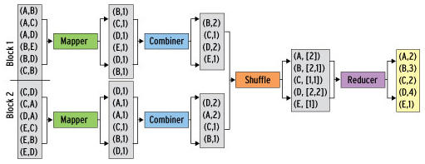
Refinement: Combiners
Back to our word counting example:
Combiner combines the values of all keys of a single mapper (single machine):
Much less data needs to be copied and shuffled!

Slide 40
Refinement: Partition Function
Want to control how keys get partitioned
Inputs to map tasks are created by contiguous splits of input file
Reduce needs to ensure that records with the same intermediate key end up at the same worker
System uses a default partition function:
hash(key) mod R
Sometimes useful to override the hash function:
E.g., hash(hostname(URL)) mod R ensures URLs from a host end up in the same output file

Slide 41
Problems Suited for Map-Reduce

Slide 42
Example: Host size
Suppose we have a large web corpus
Look at the metadata file
Lines of the form: (URL, size, date, …)
For each host, find the total number of bytes
That is, the sum of the page sizes for all URLs from that particular host
Other examples:
Link analysis and graph processing
Machine Learning algorithms

Slide 43
Example: Language Model
Statistical machine translation:
Need to count number of times every 5-word sequence occurs in a large corpus of documents
Very easy with MapReduce:
Map:
Extract (5-word sequence, count) from document
Reduce:
Combine the counts

Slide 44
Example: Join By Map-Reduce
Compute the natural join R(A,B) ⋈ S(B,C)
R and S are each stored in files
Tuples are pairs (a,b) or (b,c)
A | B
a₁ | b₁
a₂ | b₁
a₃ | b₂
a₄ | b₃
B | C
b₂ | c₁
b₂ | c₂
b₃ | c₃
A | C
a₃ | c₁
a₃ | c₂
a₄ | c₃
⋈
=
S
R

Slide 45
Map-Reduce Join
Use a hash function h from B-values to 1...k
A Map process turns:
Each input tuple R(a,b) into key-value pair (b,(a,R))
Each input tuple S(b,c) into (b,(c,S))
Map processes send each key-value pair with key b to Reduce process h(b)
Hadoop does this automatically; just tell it what k is.
Each Reduce process matches all the pairs (b,(a,R)) with all (b,(c,S)) and outputs (a,b,c).

Slide 46
Cost Measures for Algorithms
In MapReduce we quantify the cost of an algorithm using
Communication cost = total I/O of all processes
Elapsed communication cost = max of I/O along any path
(Elapsed) computation cost analogous, but count only running time of processes
Note that here the big-O notation is not the most useful (adding more machines is always an option)

Slide 47
Example: Cost Measures
For a map-reduce algorithm:
Communication cost = input file size + 2 × (sum of the sizes of all files passed from Map processes to Reduce processes) + the sum of the output sizes of the Reduce processes.
Elapsed communication cost is the sum of the largest input + output for any map process, plus the same for any reduce process

Slide 48
What Cost Measures Mean
Either the I/O (communication) or processing (computation) cost dominates
Ignore one or the other
Total cost tells what you pay in rent from your friendly neighborhood cloud
Elapsed cost is wall-clock time using parallelism

Slide 49
Cost of Map-Reduce Join
Total communication cost = O(|R|+|S|+|R ⋈ S|)
Elapsed communication cost = O(s)
We’re going to pick k and the number of Map processes so that the I/O limit s is respected
We put a limit s on the amount of input or output that any one process can have. s could be:
What fits in main memory
What fits on local disk
With proper indexes, computation cost is linear in the input + output size
So computation cost is like comm. cost

Slide 50
Pointers and Further Reading

Slide 51
Implementations
Google
Not available outside Google
Hadoop
An open-source implementation in Java
Uses HDFS for stable storage
Download: http://lucene.apache.org/hadoop/
Aster Data
Cluster-optimized SQL Database that also implements MapReduce

Slide 52
Cloud Computing
Ability to rent computing by the hour
Additional services e.g., persistent storage
Amazon’s “Elastic Compute Cloud” (EC2)
Aster Data and Hadoop can both be run on EC2

Slide 53
Reading
Jeffrey Dean and Sanjay Ghemawat: MapReduce: Simplified Data Processing on Large Clusters
http://labs.google.com/papers/mapreduce.html
Sanjay Ghemawat, Howard Gobioff, and Shun-Tak Leung: The Google File System
http://labs.google.com/papers/gfs.html

Slide 54
Resources
Hadoop Wiki
Introduction
http://wiki.apache.org/lucene-hadoop/
Getting Started
http://wiki.apache.org/lucene-hadoop/GettingStartedWithHadoop
Map/Reduce Overview
http://wiki.apache.org/lucene-hadoop/HadoopMapReduce
http://wiki.apache.org/lucene-hadoop/HadoopMapRedClasses
Eclipse Environment
http://wiki.apache.org/lucene-hadoop/EclipseEnvironment
Javadoc
http://lucene.apache.org/hadoop/docs/api/

Slide 55
Resources
Releases from Apache download mirrors
http://www.apache.org/dyn/closer.cgi/lucene/hadoop/
Nightly builds of source
http://people.apache.org/dist/lucene/hadoop/nightly/
Source code from subversion
http://lucene.apache.org/hadoop/version_control.html

Slide 56
Further Reading
Programming model inspired by functional language primitives
Partitioning/shuffling similar to many large-scale sorting systems
NOW-Sort ['97]
Re-execution for fault tolerance
BAD-FS ['04] and TACC ['97]
Locality optimization has parallels with Active Disks/Diamond work
Active Disks ['01], Diamond ['04]
Backup tasks similar to Eager Scheduling in Charlotte system
Charlotte ['96]
Dynamic load balancing solves similar problem as River's distributed queues
River ['99]

